Slide 1
Royal Canadian Legion District Sgt-at-Arms Training Roles and Responsibilities
District Sgt-at-Arms Comrade Guy Pratt
Assistant / Demonstrator Comrade Ron Heffernan

Slide 2
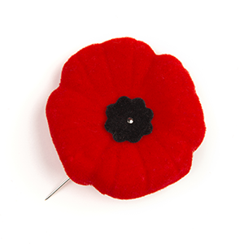
MTP:
Legion Overview
Role of the Sgt-at-Arms
Standard Legion Dress
The Poppy
Flags and Colours
The Colour Party & Parades
Legion Funerals
Basic Drill Movements
Colour Party Drill

Slide 3
Legion Overview:
Firstly known as the Dominion Veterans Alliance, founded on the 25th November 1925, Winnipeg MB.
The Legion was founded as the "The Canadian Legion of the British Empire Service League" incorporated by a special Act of Parliament and the Charter was issued July 1926.
Her Majesty Queen ELizabeth II, gave her consent to use the prefix "Royal" on December 19th, 1960.
The organization became known as "The Royal Canadian Legion" (RCL) officially in 1961 when the Act of Incorporation was amended.

Slide 4
The RCL keeps the Traditions of Remembrance alive for the future generations through various initiatives, such as...
The Poppy Campaign;
Legion Sports Programs;
Legion Youth Education Programs; and
Scholarships and bursary programs.

Slide 5
Role of the Sgt-at-Arms
Establish and maintain a Branch Colour Party;
Responsible for the Colours and Branch Insignia;
Prepare Colour Party for Legion Meetings, Parades, banquets;
Legion Dress Standards;
Initiation of members at General Meetings;
Ceremonies, ceremonial duties, special events;
Legion Funerals;
Security of meetings (only eligible attendees permitted);
Secure the doors during elections; and
Assist the President in maintaining order during Legion meetings, and to perform other duties assigned by the President.

Slide 6
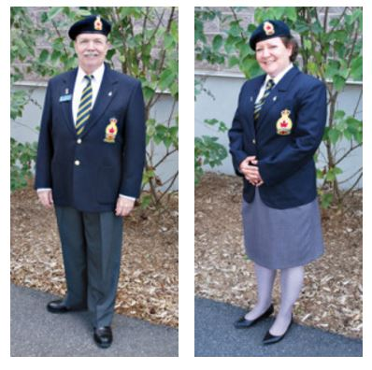
Standard Legion Dress
For Men:
For Women:
Navy Blue/Black Beret
Navy Blue Blazer
Plain white shirt
Black shoes
Dark grey hose
Grey knee length skirts or slacks
Black shoulder strap purses may be carried on parade
Small stud or keeper earrings are appropriate
Legion long striped tie
White gloves are worn by comrades participating at ceremonies
Navy Blue/Black Beret
Navy Blue Blazer
Plain white shirt
Black shoes
Black socks
Grey trousers
Legion long striped tie
White gloves are worn by comrades participating at ceremonies
How to wear the uniform correctly and at the appropriate times are clearly defined in "Rituals, Awards and Protocol Manual. This can be found online.

Slide 7
Standard Legion Dress (cont'd)
Accoutrements:
Brass Branch numerals may be worn on the beret, parallel to the head band and 1 inch to the wearer's left of the beret;
Military service medals are worn on full Legion dress, on the left side and Legion medals on the right side. If medals are unavailable, undress service ribbons may be worn.
Only one Legion lapel badge, with appropriate number of years shall be worn on the left lapel of the blazer.
(All Ordinary, Associate and Affiliate Members are entitled to the Legion Long Service lapel pin, in 5 year increments)
Canadian Armed Forces (CAF) Service lapel pin, Royal Canadian Mounted Police (RCMP), or other distinctive lapel pins may also be worn to the left of the Legion lapel pin.

Slide 8
Standard Legion Dress - Accoutrements:(Cont'd)
Occasionally, commemorative or celebratory pins may be authorized to wear only for a specified amount of time. These pins will be worn on the right lapel, parallel to the Legion pin on the left lapel.
(Current pins authorized, Legion "We support our Troops" Any subsequent pin, for the duration specified, will be worn on the inside of the "We support our Troops" pin.
Red Sash, may be worn by Parade Commander, Colour Party Commander or Sgt-at-Arms. The sash is worn over the right shoulder, across the body to the left hip.
(The only badges affixed to the sash will be, Legion Badge, Branch name, and Branch number. No other items are permitted on the sash.)
Overcoats may be worn in inclement weather.

Slide 9
Standard Legion Dress (cont'd)
Seasonal Dress:
Summer Dress:
1st day of May until the last day of September IAW the climatic conditions.
Same as the standard Legion Dress except...
Blazers not worn;
Ties are optional;
A Legion Shirt badge is displayed on the shirt pocket;
No epaulette with shoulder badges are to be worn;
No full Dressed Medals;
Undressed Ribbons may be worn above the left pocket;
Name tag worn above right breast pocket; and
One specialist skill pin may be worn above the Undress Service Ribbons.

Slide 10
Standard Legion Dress (cont'd)
Legion Informal Dress:
Blue Shirt (Purchased through the Legion (embroidered with the Legion Crest);
Grey Legion Pants; or Skirt;
Black socks and shoes;
Below the crest will be pinned the member designation (Ordinary, Veteran, Associate, Affiliate or Life Member) {Purchased Separately}
No other pins, blazers, ties, medals, ribbons etc... will be worn;
Informal Dress may be worn at the following...
Convention business sessions (excluding opening ceremonies);
Various Legion meetings (Executive, General, and Special Occasions.)
Informal Branch events which do not require the grey pants, black shoes are...(See note);
Hospital visitations to Veterans; and
Sports events.
NOTE: Blue Legion collared shirt may be worn with pants/shorts and shoes of choice.

Slide 11
The Poppy

Slide 12
History of the Poppy
The significance of the Poppy can be traced back to the Napoleonic Wars in the 19th Century. (over 110 years before being adopted by Canada)
Records from that time indicate how thick poppies grew over the graves of soldiers in the area of Flanders, France.
The person to first introduce the Poppy to Canada and the Commonwealth was Lieutenant-Colonel John McCrea.
The idea for the Remembrance Poppy was conceived by Madame Anna Guerin of France, inspired by Lt-Col McCrea's poem (In Flanders Fields);
She created poppies made from fabric to raise funds for a charity she founded to assist in the rebuild the regions of France torn apart by the Great War.
She later presented her concept to France's Allies (including the precursor to The Royal Canadian Legion (The Great War Veterans Association).
It was officially adopted on the 6th July 1921

Slide 13
The Poppy
Today the Poppy is worn each year during the Remembrance period to honour Canada's fallen.
The Legion also encourages the wearing of the Poppy for...
The funeral of a Veteran;
For any commemorative event honouring Fallen Veterans
It is not inappropriate to wear a Poppy during other times to commemorate Fallen Veterans, and it is an individual choice as long as its worn appropriately.
Thanks to the millions of Canadians who wear the Legion's lapel Poppy each November, the little red flower has never died, and the memories of those who fell in battle remain.
The lapel Poppy is worn...
on the left lapel immediately above the Legion lapel badge (Bazer);
Immediately above and centered on the shirt badge (Short Sleeve Summer Dress); and
When faced with inclement weather, the Poppy is worn on the left side of the outer garment close to the heart.

Slide 14
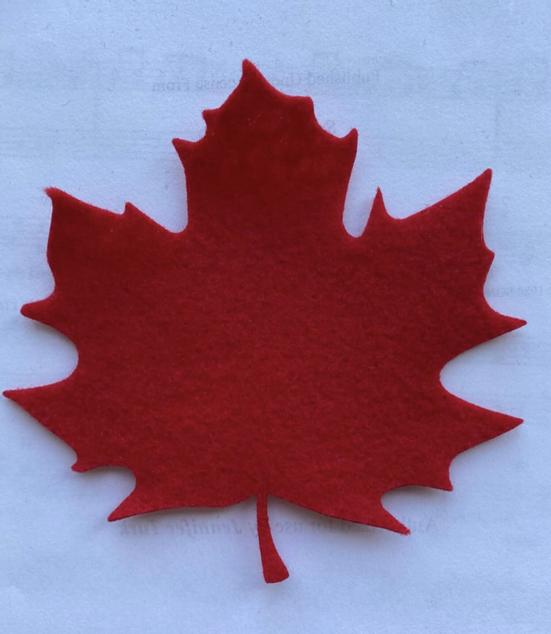
The Red Maple Leaf
The Red Maple Leaf may be worn during the Legion Tribute at the funerals of Ladies Auxiliary members and Legion members who were not veterans or ordinary members.
The Red Maple Leaf is worn in the same manner as the Lapel Poppy. This is the only occasion where the Red Maple Leaf is authorized to be worn or utilized.

Slide 15
Legion Emblems
The Canadian Red Ensign -
The 1922 t0 1957 version flew over Canada during WWII, the Korean War, the reigns of King George V, King George VI, and the Coronation of Her Majesty Queen Elizabeth II.
The Royal Union Flag -
More commonly known as the Union Jack. It is a symbol of Canada's membership in the Commonwealth of Nations and of her allegiance to the Crown and our affiliation with the Royal Commonwealth Ex-Services League (RCEL).

Slide 16
Legion Emblems (Cont'd)
The Legion Banner -
The blood red poppy of Flanders is immortalized as an emblem of sacrifice and Remembrance honouring the thousands who have laid down their lives for those ideals which we, as Canadians, cherish.
The Torch -
Is symbolic of justice, honour, and freedom for which our comrades fought and died. We who are left must pledge ourselves to hold it high lest we break faith with those who have died.

Slide 17
Our Badge
- Is a symbolic badge. It was approved by the Sovereign. It is to be worn honourably and proudly.

Slide 18
The Crown
- is the St. Edward Crown (Used by the current day Sovereign)
The Red Maple Leaf
-on a white background, is derived from the Canadian Coat of Arms.
Our Pledge and Motto
- Memoriam Eorum Retinebimus (We Will Remember Them)
The word LEGION
-in gold, with a blue background representing the official colours of the Legion.
The Poppy
is the symbol of Remembrance.
THIS BADGE – was approved by the Sovereign. It is to be worn honourably and proudly.

Slide 19
Flags and Colours
For the purpose of this presentation, the term "flag" will also signify jacks, banners, pennants, ensigns and standards.
The current Canadian Flag was adopted on the 15th February 1965. It has flown proudly over Canadian Soldiers during United Nations (UN) missions, NATO missions, the Gulf War, The Afghanistan War and the War on Terrorism.
The Canadian Flag holds the position of honour when flown with other flags, except for the personal standards of members of the Royal Family or of the Royal Families representatives (Governor General, Leftenant Governors).
At all times, the National Flag and all others, will be treated with dignity and displayed properly.
Flags shall never touch the ground, floor or deck.

Slide 20
Flags and Colours (Cont'd)
The Canadian flag may be displayed horizontally or vertically on a wall.
Horizontally
The sleeve shall be to the left.
Vertically.
The top of the leaf is to the left and the stem is to the right.

Slide 21
Half Masting
A flag flown at half-mast is the universal symbol of mourning.
The rules of half-masting are as follows...
Only flags secured to flag poles, with halyards and pulleys, will be half-masted;
All other flags flown with the National flag, shall be half-masted;
Throughout the country upon the death of the Sovereign, a member of the Royal Family (in the first degree related to the Sovereign), the Prime Minister, the Governor General, a Federal Cabinet Minister, the Dominion President, a past Dominion President, and any other occasion as specifically directed by Dominion Command;
Within a Province/Territory upon the death of the Lieutenant-Governor, the Premier, a Cabinet Minister, the Provincial President, and any other occasion as specifically directed by Provincial Command;

Slide 22
Half Masting. (Cont'd)
Within a riding upon the death of a member of the House of Commons;
Within a District, upon the death of the District Commander, or former District Commander;
Within a Zone upon the death of the Zone Commander or former Zone Commander;
At a Branch, upon the death of a member of the Branch or Ladies Auxiliary, and at the discretion of the Branch upon the death of a Veteran or member of the CAF.

Slide 23
REMEMBRANCE DAY – HALF MASTING (National)
It is now Canadian Government policy that all external Canadian Flags are to be flown at half-mast on Remembrance Day “to honour the memory of all Canadians who have served their country in times of war”. The policy is as follows:
The Canadian Flag will be flown at half-mast on all federal government buildings and establishments across Canada from sunrise to sunset on Remembrance Day;
Should half-masting occur near a cenotaph or at another site where Remembrance services are being observed, half-masting can occur from 11:00 a.m. (or according to the prescribed order of service) and extend until sunset on November 11;
The flag on the Peace Tower will fly at half-mast from the commencement of the Remembrance Day service at the National War Memorial in Ottawa, Ontario, and remain in that position until sunset

Slide 24
REMEMBRANCE DAY – HALF MASTING (Legion Policy)
Legion Policy. In order to conform to this Government policy the Legion policy for half-masting the Canadian Flag on Remembrance Day is as follows:
a. Canadian Flags flown outside Legion establishments where Remembrance Day services will not occur will be flown at half-mast for the day;
External Canadian Flags flown at Branches or cenotaphs where a Remembrance Service will occur will be flown at full-mast until the playing of the first note of the Last Post, and then lowered as per custom. The flags will be raised to the full-mast position on the first note of Rouse and remain so during the playing of the Royal Anthem and march past if applicable;
Note: All wreaths are to be removed the following day of the Ceremony or during the next week at the latest.

