Slide 1
WELCOME
2024
DISTRICT “F”
POPPY SEMINAR
Notes:
Good morning Comrades welcome to our poppy seminar for those of you that do not know me my name is Al Plume
If you have questions please do not wait, ask them right away. I only ask that your questions are relevant to the material being discussed. If I can not answer your questions I will write it down and report it back thru your Zone Chairs.
Before we get started
How many new Branch Poppy Chairs are here today

Slide 2
AGENDA
PURPOSE OF SEMINAR
PURPOSE OF POPPY CAMPAIGN
NEW POPPY MANUAL
RESPONSIBILITIES
DO’S AND DON’TS
SPECIAL USE EXPENDITURES
REPORTING
QUESTIONS

Slide 3
PURPOSE OF SEMINAR
Share information & Offer Guidance
An opportunity to learn and to Reinforce what you already know

Slide 4
PURPOSE OF THE POPPY FUND
THE LEGION AND IT MEMBERS ARE THE GUARDIANS OF REMEMBRANCE
FOR THE CARE FOR OUR VETERANS AND THEIR FAMILIES
TEACH OUR YOUTH

Slide 5
THE POPPY MANUAL
Current Poppy Manual June 2024 Edition
Printable version available on the Ontario Command website. Hard copies are no longer available for purchase from Provincial Headquarters.
Most other Poppy reference materials available
www.on.legion.ca
Forms and Manuals
Poppy Section
Poppy Kits

Slide 6
RESPONSIBILITIES
ACTIVE PARTICIPATION IN THE POPPY CAMPAIGN IS AN OATH UNDERTAKEN WHEN BECOMING A MEMBER OF THE ROYAL CANADIAN LEGION

Slide 7
RESPONSIBILITIES BRANCHES
THE POPPY CAMPAIGN IS THE MOST IMPOTANT
BRANCH PROJECT OF THE YEAR
BRANCH PRESIDENT HAS OVERALL RESPONSIBILITY
OPENING THE CAMPAIGN
Ceremonial Opening
First Poppies to the Governor General and Lieutenant Governors
DOES NOT start the Campaign
Official Opening
No earlier than the last Friday in October
October 25, 2024

Slide 8
RESPONSIBILITIES BRANCHES cont’d
Branch Poppy & Remembrance Chairperson
Forms a Poppy Committee (the Branch Service Officer should be part of this Committee S. 604.)
Obtains local authority to canvass, if required
Ensures supplies are only purchased through Ontario Command
Ensures Poppy Trust Funds are used, recorded, audited and reported in accordance with General By-Laws, Provincial By-Laws and the Poppy Manual

Slide 9
BRANCH POPPY COMMITTEE
Ensures the general public is informed, through the local media, of the campaign results including the contributions received and the distribution of funds (S. 606)
Ensure material on hand is in good repair
Canvass businesses for them to purchase wreaths, etc.
Wreaths placed and removed at the Cenotaph
Recruit canvassers
Schedule volunteers

Slide 10
BRANCH POPPY COMMITTEE cont’d
For money counting have a separate room with adequate security
Donations counted (2 People minimum), recorded, deposited as quickly as possible
Poppy Trust Fund Account is to be separate from the General
Funds must remain under the control of the Legion
Both Poppy Chair and Service Officer shall have signing Authority on the Poppy account depending on the Branches approved Regulations.

Slide 11
BRANCH POPPY COMMITTEE cont’d
A Campaign Checklist “Putting it all together” Can be found in Section 319 of the Poppy Manual on page 19
There is also a checklist at the front of the Promotional Material Catalogue

Slide 12
POPPY TRUST FUNDS
Poppy funds may not be used as general or any other Branch funds
Can only be used as specified by the POPPY MANUAL
Improper use of these Funds will result in repaying the amounts
ZERO TOLERANCE ON THEFT

Slide 13
DO’S AND DON’TS
Campaign Eligible Expenses
Poppies, wreaths, canvassing supplies and promotional material for the annual Poppy Campaign.
Branches can purchase a Ribbon Machine and ribbon supplies.
Storage cost (Special Use approval)
Interior at the Branch –max. 3 months (1 Sep to 30 Nov)
$7.00 per sq ft (total max of $350.00/ year
Exterior warehouse space –max. 3 months
$3.50 per sq ft (total max of $175.00/ year

Slide 14
Eligible Expenses con’t
Reasonable local administrative costs directly related to the campaign Telephone charges (3 months only), coin wrappers, postage, stationary, advertising, bank charges, refreshments and light lunches for canvassers and / or volunteers (coffee, juice, soup, sandwiches or donuts only)
Other similar costs, with receipts, may be considered
Always keep your receipts!
Up to 50% of the cost of a bugler and/or piper to a maximum of $100.00 during the Remembrance Day ceremony only

Slide 15
Eligible Expenses cont’d
Assistance
Reasonable expenses of the Provincial Command Service Officer that are directly related to service work, including seminars
Reasonable expenses of the Branch Service Officer that are directly related to service work including seminars. Examples are: Mileage expense at the current provincial rate (not Fuel Expense)to assist a Veteran to attend an appointment. S 402 iii, (b)

Slide 16
Eligible Expenses cont’d
Personal comforts for Veterans and their widows/widowers who are hospitalized, in long term care facilities, in a nursing home or who are incapacitated and are being cared for at home or those currently serving members deployed outside of Canada. These comforts are defined as food items fruit, sweets, etc., reading material, flowers, personal toiletry items, writing materials, postage and temporary TV rental. Other costs of a similar nature may be considered
Acquisition, maintenance or rental of a medical alert system for Veterans and their widows/widowers to a maximum of $1500.00 annually

Slide 17
Eligible Expenses cont’d
Emergency Assistance – defined as shelter, food, fuel, clothing, prescription medicine, medical devices / equipment and necessary transportation. Assistance for the purchase of cell phones, with no fixed plans attached, that can be reloaded with minutes.
Assistance cannot be continued over an extended period but may be offered more than once to an individual.
Always reach out to your Provincial Service Officer.

Slide 18
Eligible Expenses cont’d
Donations to the RCEL Royal Commonwealth Ex-Services League as per Section 401 – SUF not required
Accounting
Reasonable expenses incurred for the required external audit of the Branch Poppy Trust Account

Slide 19
Eligible Expenses cont’d
Seminars
Branch Poppy Chair and Branch Service Officer (or delegate) to attend Poppy and Service Officer Seminars
Reimbursement of reasonable expenses incurred by Branches in hosting any type of Mental Health seminar, education program, OSI/PTSD program or any type of Mental Health First Aid training to acquire the skills to assist Veterans and their families

Slide 20
Eligible Expenses cont’d
Education
The granting of bursaries – following the guidelines in the Poppy Manual under S. 402. vi.
Donate to the Ontario Command Bursary Fund, Charitable Foundation, Homeless Veterans Fund/Operation Leave the Streets Behind and Operation Service Dogs
Youth Ed Chair - Distribution of Poppy and Remembrance material to be used in schools.
Prizes for Poster and Literary Contests only does not include the Public Speaking prizes

Slide 21
Expenses Not Covered
Hot meals and alcohol-based beverages for Poppy Campaign organizers, workers and volunteers
Expenses incurred for Remembrance Day ceremonies and Decoration Day ceremonies
Purchase or rental of installation of public address systems at cenotaphs
Basically, nothing related to funerals for Veterans or their families- or anyone else including headstones, grave markers, memorial plaques for cenotaphs, pipers, buglers, lunches, receptions, etc.

Slide 22
Expenses Not Covered Cont’d
The payment of property taxes for veterans
Money for death benefit funds at branches
Home care, housekeeping, grounds keeping, such as grass cutting and snow removal (should contact Provincial Service Officer regarding VIP program)
Loans
Comforts for senior citizens except as in section 402 iii c

Slide 23
Expenses Not Covered Cont’d
General or non-specific donations to charities, registered or non-registered, or not-for-profits that do not meet the criteria listed in Sections 401, 402 or 403.
Examples: Heart and Stroke, Canadian Cancer Society, March of Dimes, etc.
Or for administrative or operational expenses of any organization.
When in doubt, contact Ontario Provincial Command for direction. poppyspecialuse@on.legion.ca

Slide 24
Expenses Not Covered Cont’d
Branch related utilities, expenses and leases, rent and mortgages
Any expenses incurred at conventions
Renovations of any sort to a branch premises except in Subsection 403. ii.j
The purchase of medals, including war medals
Funding of scholarships
Public speaking events
Honour roll plaques for schools

Slide 25
Expenses Not Covered Cont’d
Donations to events, schools, youth groups or Legion oriented programs
Public service projects such as donations to churches, memorial funds, recreational facilities, furnishings and non-medical equipment for hospital wards/ rooms

Slide 26
ANY QUESTIONS
ON THE
DO’S AND DON’TS

Slide 27
SPECIAL USE EXPENDITURES
Prior to funds being utilized for “SPECIAL USE” the Branch Poppy Trust Fund must obtain approval for the proposed expenditure at an Executive or General Meeting of the Branch
The request should include
the amount, the recipient(s)
current balance at time of request
the purpose of the request
date of the Executive or General Meeting at which the decision was approved

Slide 28
SPECIAL USE EXPENDITURES cont’d
Must only use current form on the Ontario Command Website ( dated July 2024)
Repeating expense, e.g. elevator maintenance, a new submission is required as a “Up To” for the year (receipts still need to be submitted) or each individual invoice to be submitted
Must be approved by Ontario Command before funds are used
Failure to secure approval prior to the funds being used, will result in the offending branch being required to repay the amount from branch general fund

Slide 29
SPECIAL USE EXPENDITURES cont’d
For each Special Use Expenditure outlined in this article, Branches are limited by the maximum percentage of the account balance
Multiple allocations may be made in each category of use provided that the total does not exceed the max %
Forms should be Submitted by e-mail to poppyspecialuse@on.legion.ca
Command will review and reply by e-mail with copy of form showing Approved, Inadmissible or More Information Required

Slide 30
SPECIAL USE EXPENDITURES cont’d
Branch must confirm receipt and reply by e-mail by ‘send receipt” ; if no confirmation sent, Command will mark the file as NULL AND VOID

Slide 31
SPECIAL USE APPLICATION FORM
COMPLETING THE FORM
PART A- Branch Name, Number, District, Date, Address, Phone, Email address, and the Contact Name and Home phone number
PART B – one request per form, e.g. if applying for donations to both Operation Service Dogs and the Cadets, two separate forms must be submitted
PART C – Name of Recipient
How funds will be used

Slide 32
SPECIAL USE APPLICATION FORM
COMPLETING THE FORM cont’d
PART C
Cheque payable to, Description
Current Poppy Account Balance
Amount Requested and Projected Cost
Date of Executive ot General Meeting
Motion moved by and Seconded by
Signed by Poppy Chair and Branch President( if President is the Poppy Chair, First Vice-President must sign)
E-mail to Ontario Command at poppyspecialuse@on.legion.ca

Slide 35
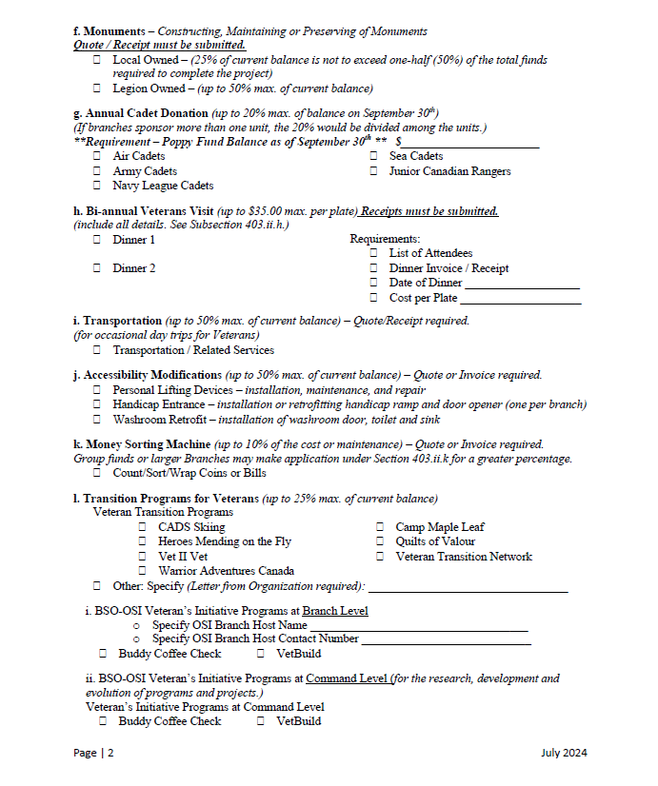

Slide 39
AUTHORIZED SPECIAL USE EXPENDITURES
Housing Accommodation, Care Facilities or Hospice (50%)
Medical Training and Medical Research (50%)
Medical Appliance (50%)
Veteran Services (50%)
Relief of Disasters (50%)
Monuments (25%) or (50%) if Legion Owned
Annual Support of Cadet Units (20%)
(Sept 30th Balance Required)
Bi-annual Veterans Visit (up to $35.00 per plate –maximum)

Slide 40
AUTHORIZED SPECIAL USE EXPENDITURES
Transportation (50%)
Accessibility Modification (50%)
Coin Sorting Machine (10%)
Veterans Transition Programs (25%)
BSO-OSI Veteran’s Initiative – Branch Level
ii. BSO-OSI Veteran’s Initiative – Command Level
Operational Stress Injury - Service Dogs (25%)
Support to Resource Centres (25%)
Support to a Visiting Hospice Program (25%)
Custom-Made Adjustable Sports Equipment & Recreational Gear (25%)

Slide 41
SUF’S are being sent back because of missing signatures, no motions or seconder, no quotes or invoices attached, no Meeting dates, no information as to where the funds are going to (Cheque Payable To), email addresses are missing.
Negative comments to Provincial Headquarters Staff are unnecessary.

Slide 42
If a SUF has been deemed Inadmissible, it is because the request did not comply with the Poppy Manual.
If inadmissible look at other sources to assist such as Charitable Foundation, you can go on the website under Charitable to see where in your area donations have been made. The Officer’s Manual also has a section on Charitable Donations.
If a SUF has been returned as Incomplete, it is because the request is missing or needs additional information. Complete the request and return to Ontario Command for review and consideration.

Slide 43
ANY QUESTIONS
ON SPECIAL USE EXPENDITURES

Slide 44
BRANCH STATUS REPORT
TITLE LINE
For the year = 1 Jan 2024 – 31 Dec 2024
Branch = Branch number
Command = Ontario (05)
Completed = Date you completed the statement (day, month, year)

Slide 45
BRANCH STATUS REPORT cont’d
SECTION A
Year = 2024
Amount = The closing balance from your previous year’s report which is also the same as your Poppy account. (please use this balance otherwise your report will be incorrect)
SECTION B
Income from campaign and all other sources which is the sum of all monies credited to the Poppy Account for the year. Do not include investments in this section, this goes in Section H.

Slide 46
BRANCH STATUS REPORT cont’d
SECTION C
The total of Boxes A & B
SECTION D
D1 = Amount of money paid to Command for Poppies and Wreaths
D2 = Amount of money paid to Command for promotional material such as manuals, receipt books, canvassing trays, counter top boxes, etc.

Slide 47
BRANCH STATUS REPORT cont’d
SECTION D cont’d
D3 = Stamps for campaign
D4 = Advertising in local paper including Campaign Results (S. 606)
D5 = This is when you should fill out your POPPY TRUST FUND STATEMENT which is where you list all of your Poppy Campaign expenses not already reported in D1,D2, D3, D4

Slide 49
BRANCH STATUS REPORT cont’d
SECTION D cont’d
D6 = The total of D1, D2, D3, D4, D5
SECTION E
When getting ready to fill in Section E you should fill out your POPPY TRUST FUND BREAKDOWN SHEET. Example below

Slide 52
BRANCH STATUS REPORT cont’d
SECTION E cont’d
E1 = Amount of money paid for the benefit of Veterans or dependants. These monies are usually paid to third parties for glasses, dentures, medical devices, heating oil, etc. You should be contacting the Provincial Service Officer for direction before paying out from your Poppy Trust Funds.
(this amount is taken from your Poppy Trust Fund Breakdown Sheet)
E2 = Amount of Bursaries either paid out directly (following the guidelines in the Poppy Manual under Education (S. 402. vi. a.)or via Ontario Command’s Bursary Fund. Money is not allowed to be given to any “School” directly or to any student as a Scholarship.
Any Amount over $500.00 must have a T4A issued by the Branch and a T4A Summary sent to the CRA.

Slide 53
BRANCH STATUS REPORT cont’d
SECTION E cont’d
E3 = Amount of donations entered here are the total “Non Special Use” and the “Special Use “ expenditures as authorized in the current Poppy Manual. (this amount is taken from your Poppy Trust Fund Breakdown Sheet)
E4 = LEAVE BLANK NOT APPLICABLE FOR ONTARIO COMMAND

Slide 54
BRANCH STATUS REPORT cont’d
SECTION E cont’d
E5 = Prizes only for Literary and Poster Contests. Public Speaking prizes are not eligible from Poppy Trust Funds.
E6 = the total of E1, E2, E3, and E5
SECTION F
F = the total of box D6 and E6

Slide 55
BRANCH STATUS REPORT cont’d
SECTION G
Year = 2024
Box G Represents the balance in the Poppy Trust fund account as of Dec 31st 2024 and is calculated by subtracting the amount in Box F from the amount in
Box C

Slide 56
BRANCH STATUS REPORT cont’d
SECTION H
Box H Represents the amount of Poppy Trust Fund Investments as of Dec 31, 2024
GIC’s, INVESTMENTS: These are allowed as a GIC can be appointed to a specific situation. S.608. GIC’s and Investments are to be Short Term (2 years less 1 day) they should be directed back to your Poppy Trust Fund Bank Account, another Investment may be made after General Membership Approval.
Interest from Bank Accounts and Investments should be reported under B – Income from Campaign and all other sources

Slide 57
BRANCH STATUS REPORT cont’d
SECTION I
Box I Represents the FINAL TOTAL BALANCE of all Poppy Trust Funds as of Dec 31th 2024

Slide 58
BRANCH STATUS REPORT cont’d
CERTIFICATION
The BSR is to be signed by the Poppy Chair and the Branch President. The First Vice-President must sign if the President is the Poppy Chair.
Electronically send or mail the BSR and required paperwork must be sent to the Zone Poppy Chair as soon as possible after December 31, 2024.

Slide 60
A copy of the Poppy Fund Ledger must be included with the financial year end report. When using a Ledger confidentiality is vital. DO NOT USE NAMES. Veterans may be assigned a letter or a number.
Media: Follow S.606. It is mandatory to do a media report. Report to the media what your Branch does, this is vital for the community to know.

Slide 63
What your Zone Poppy needs from you!
The following items must be sent electronically if possible (if not a copy of all is required) to Zone Poppy:
Completed Branch Status Report Poppy Trust Fund
Poppy Trust Fund Statement D5 Expenses
Poppy Trust Fund Breakdown Sheet
Copies of each Special Use Form
Financial Review Certification
Copy of the Poppy Ledger

Slide 64
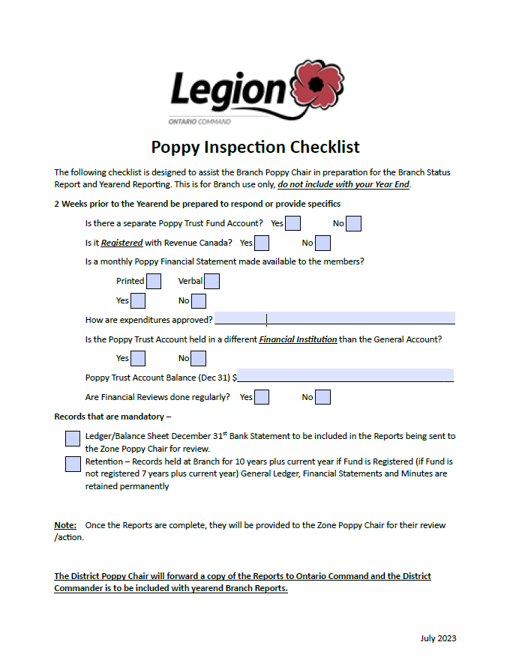

Slide 65
COUNTER TOP BOX REPORT cont’d
Form is straightforward
Fill in your Branch, District, Zone information
Fill in the number of LCBO stores, Beer stores and Costco where you had Poppy boxes on the counters and the total amount of money collected through tagging
Form needed even if there are no stores in your area, please fill out the top of the Form with your Branch, District and Zone information and submit.
To be sent to your Zone Poppy Chair by 1 Dec 2023.

Slide 67
GENERAL
Everyone needs to follow the Chain of Command. The Chain of Command starts with the Branch, then to Zone, then to District, then to Provincial Command, and then Dominion Command through Provincial Command.
Every Branch needs to get their Reports in on time and completed correctly. Ask for assistance if necessary.

Slide 68
GENERAL Cont’d
As Poppy Chair you should be working with your Branch Service Officer when dealing with Veterans who come to your Legion requesting financial help following the chain of Command to your Provincial Service Officer.
DO NOT PAY FOR HOTEL ROOMS, offer them a second solution, shelter or safe home. Thank them for coming in. Have them fill out a Legion Claim Form with the Service Officer and a Homeless Veterans Form to submit to Ontario Command.
REMEMBER, THIS IS A PUBLIC TRUST FUND.

Slide 69
GENERAL Cont’d
Travelling Veterans:
Some people (Veterans or not) are travelling from Branch to Branch asking for assistance. Please advise Ontario Command/Provincial Service Officer if assistance is going to be provided to help prevent abuse of the Trust Funds
POPPY TRUST FUNDS ARE NOT A SUBSIDY PROGRAM.

Slide 70
GENERAL Cont’d
Service verification is required
Take the time to ask questions:
What is your Service Number?
Speak to them in a way that does not come across as interrogating them.
Have them sign a Veterans Assistance Form and Legion Claim Form so they can get further help.

Slide 71
ATTENTION
MAKE SURE TO USE UP TO DATE FORMS, THESE FORMS ARE AVAILABLE AT www.on.legion.ca under Forms and Manuals – Poppy Kit
Any Forms that are outdated will be returned to the Branch and you will be asked to resubmit your work on the new Forms ( July 2024)
Clean out your files and throw out the old Forms!

Slide 72
GENERAL
Before you spend any Poppy money, read the Poppy Manual section of Do’s and Don’ts and make sure you can spend this money.
All expenses and donations must be approved by the Executive or General Membership.
Don’t spend money before you receive approval from Ontario Command because all unapproved spending will mean the money will have to be paid back to the Poppy Trust Fund from your General Fund account.

Slide 73
GENERAL
Not sure if you’ve done things correctly or have any questions?
Contact your Zone Poppy Chair with any and all of your concerns. Zone is here to help you. If Zone doesn’t know the answer, then Zone will contact the District Poppy for advice. Follow the Chain of Command!

Slide 74
RESOLUTION
Don’t like something about Poppy uses?
Submit a Resolution to get it changed
The Ontario Command Website at
http://www.on.legion.ca/docs/default-source/PDF/forms/resolutionformforsubmissionoprovincialcommand_000.pdf?sfvrsn=8

Slide 75
RESOURCES
The Dominion General By-Laws
The Provincial By-Laws
The Poppy Manual
The Officer’s Manual
Make sure you are using the most current Manuals. They can be found on the Provincial - www.on.legion.ca and Dominion – www.legion.ca Websites.

Slide 76
QUESTIONS

