Slide 1
VIMY RIDGE DAY – Half Masting
The federal government enacted legislation in 2003 declaring April 9th Vimy Ridge Day, a “National Day of Remembrance” to commemorate this famous battle where Canadians did what others could not; capture Vimy Ridge.
The Canadian Flag, on the Peace Tower, will be flown at half-mast on the 9th of April from sunrise to sunset.
Legion Branches are to fly their Canadian Flags at half-mast on 9 April from sunrise to sunset.

Slide 2
The Colour Party and Parades
Dress and Deportment.
Members of the Colour Party, including the Colour Party Commander and Parade Commander, shall wear Legion dress with everyone having the same standard of dress.
The Colour Party may be commanded by:
A Sgt-at-Arms;
A Colour Party Commander; or
The Comrade carrying the Canadian Flag.
The term Colour Party is to be interpreted to mean any of the appointments listed above and the group of persons carrying the flags.
Comrades selected to be part of the Colour Party must receive training that addresses basic drill movements, flag protocol and flag drill.

Slide 3
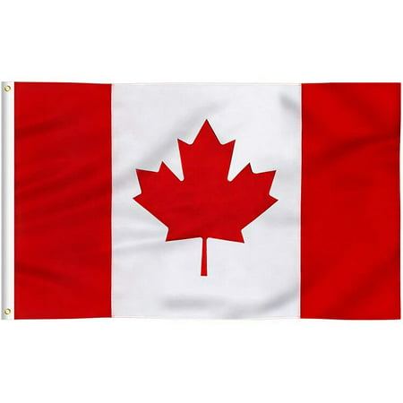
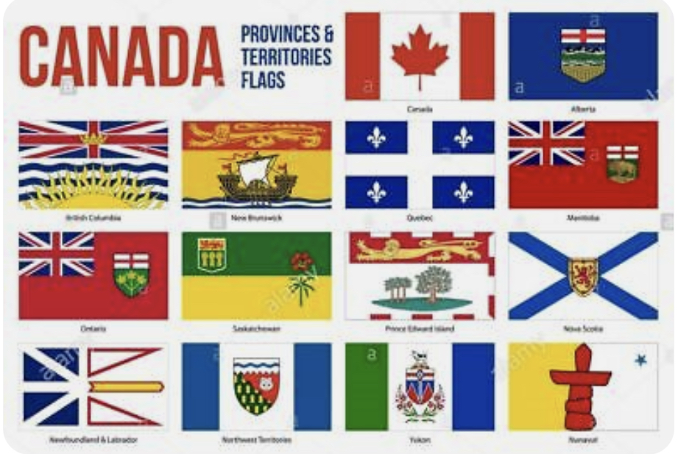
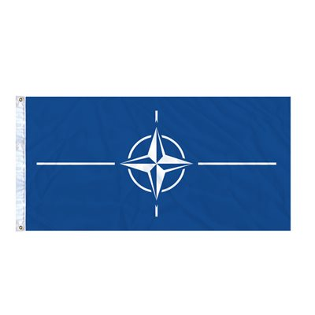
The Colour Party (Consists of)
The Canadian Flag;
The Red Ensign(1922 – 1957);
The Royal Union Flag;
The appropriate Provincial or Territorial flag(s);
The United Nations (UN) Flag;
The NATO Flag;
The Legion Banner; and
The Ladies Auxiliary Banner.

Slide 4
Colour Party (Cont'd)
There may be enhanced Colour Parties that, in addition to the flags referred to in the previous slide, will carry ALL other Provincial and Territorial Flags.
The Dominion Command Colour Party carries 19 flags. The Six Colours and the 13 Provincial and Territorial Flags.
Note: While the composition of the Legion Colour Party remains unchanged, Legion activities may include other flags and banners in a parade that would follow the Legion Colour Party. The placement of such other flags and banners is at the discretion of the Legion organizers so long as they follow the Legion Colour Party.

Slide 5
Funerals:
Within the Royal Canadian Legion, there are two forms of a funeral service for departed comrades. The services are:
A funeral service for a Veteran and other Ordinary members;
A funeral service for all other members – Associate, Affiliate voting and non-voting and members of the Ladies Auxiliary.

Slide 6
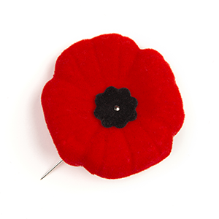
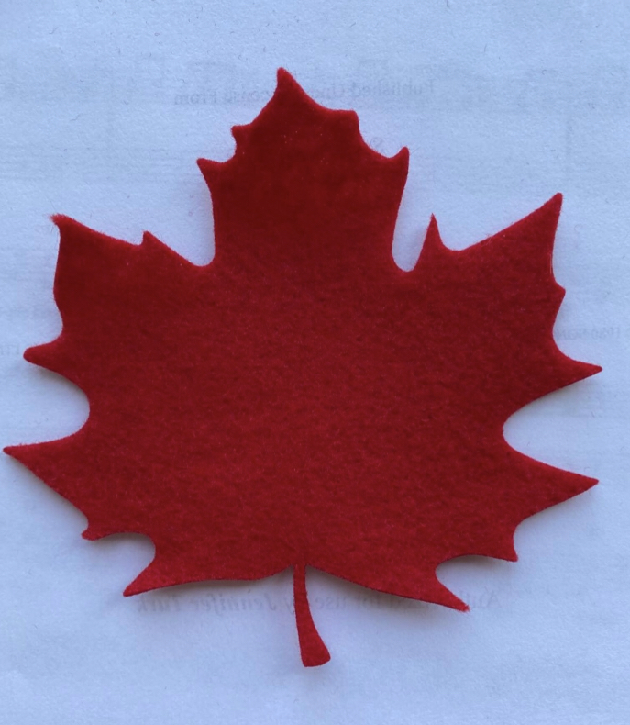
Funerals (Cont'd)
Symbols:
The symbols used at the Legion Tribute are:
The Lapel Poppy used at a funeral service for a Veteran and other Ordinary members;
The Red Maple Leaf at funerals of Ladies Auxiliary and Legion members who were not Veterans or Ordinary members.
Note: The Red Maple Leaf is worn in the same manner as the lapel Poppy. This is the only occasion where the Red Maple Leaf is authorized to be worn or utilized.

Slide 7
INSTALLATION OF OFFICERS AND EXECUTIVE MEMBERS
All officials participating in an Installation Ceremony are to be in full Legion dress including medal(s), beret and gloves. When this procedure is used for Command, District and Zone installations, substitute the appropriate word for “Branch” wherever necessary.
The President appoints an Installing Officer and a Sergeant-at-Arms for this ceremony.
As the Sgt-at-Arms is the first Branch Officer to be installed, this person may relieve the Acting Sergeant-at-Arms from his duties once the installation has taken place.

Slide 8
INSTALLATION OF OFFICERS AND EXECUTIVE MEMBERS (Cont'd)
The Installing Officer instructs the Sergeant-at-Arms to escort each Officer from the rear of the hall or other gathering area to the platform for installation.
The Vice-Presidents are escorted as a group together as are the members of the Executive Committee.
Following each installation, congratulations should be extended by the Installing Officer.

Slide 9
The Installation Ceremony
The Installation Ceremony commences when the Installing Officer moves to the podium and states: INSTALLING OFFICER The meeting will come to order.
The practice is to parade the incoming Branch President, Zone Commander and the District Commander for installation with the Branch, Zone or District Colours.
The Canadian Flag is on the left, and the Legion Banner on the right, behind the person being sworn in. Once you have reached the Installing Officer and halt, the Sgt-at-Arms will order a inwards turn, the two flags will cross, with the Canadian Flag in front of the banner.
Members of the Royal Canadian Ladies Auxiliary support the aims and objectives of the Legion and their dedicated service enrich the programs and activities of our branch.

Slide 10
Marching On The Colours at the opening and closing ceremonies of legion meetings.
Marching on the Colours
The Sgt-at-Arms forms up the Colour Party at the rear of the hall being used for the assembly.
Once the assembly has been called to order, the Chairman will give the command “MARCH ON THE COLOURS”.
The Sergeant-at-Arms, in a clear and strong voice, orders “CARRY COLOURS ...... QUICK MARCH”. If a band is present appropriate music is to be played. The bandmaster’s cue to commence playing is the word of command “MARCH”; therefore a clear and strong voice is necessary;
the colour party, in single file, marches along the centre aisle. Upon reaching the head table area of the assembly, the file marches to the end of the head table, and must manoeuvre in a manner that will permit them to move behind the head table area to the applicable flag base. The Sgt-at-Arms moves independently to a position in front of the head table area, halts and controls the Colour Party from this position;

Slide 11
Marching On The Colours at the opening and closing ceremonies of legion meetings. (Cont'd)
Marching on the Colours
The Colour Bearers make a left wheel lining themselves off with the flag bases marking time and the band ceases playing music. The Sgt-at-Arms, ensuring that a standard pause is observed, orders “HALT ..... INWARDS TURN ..... DEPOSIT COLOURS”;
When the Colours are deposited in the flag bases and adjustments have been completed, the
Sgt-at-Arms orders “ATTENTION”;
The chairman orders “COLOUR PARTY WILL RETIRE”;
The Sgt-at-Arms orders “RIGHT TURN ..... QUICK MARCH”. The band plays appropriate music. The file steps off, marches out in front of the head table area, and along the centre aisle to the rear of the assembly hall.
The Sgt-at-Arms marches to the rear of the Colour Party;
The band ceases playing when the Colour Party reaches the rear of the assembly area where the Colour Party is halted and fallen out.

Slide 12
Marching Off The Colours.
Marching On The Colours at the opening and closing ceremonies of legion meetings. (cont’d)
At the conclusion of a parade, the Parade Commander gives the order “MARCH
OFF THE COLOURS”.
The Colour Party Commander gives the appropriate order(s) - i.e. CARRY COLOURS, if required directs a
RIGHT OR LEFT TURN, QUICK MARCH to move the Colour Party to a designated area adjacent to the parade for dismissal. If a band is present appropriate music is to be played.

Slide 13
Marching On The Colours at the opening and closing ceremonies of legion meetings. (cont’d)
Marching Off The Colours.
To recover the Colours at the Closing Ceremony and upon direction from the
Chairman, the Colour Party marches in single file to, and is halted behind the Colour for which each bearer has responsibility. The Commands “RETRIEVE COLOURS ..... RIGHT TURN..... QUICK MARCH” are given.
The Colour Party departs via the same route as they departed after depositing the colours at the Opening Ceremony. Music is played, and once the Colour Party has reached the rear of the assembly hall the Colour Party is ordered to “HALT” and the music ceases. The Sergeant-at-Arms dismisses the Colour Party.

Slide 14
Note - BREAKING THE COLOURS – At no time should members walk through the Colours once they have been posted for Legion meetings or Conventions. When the colours are being posted for large assemblies, meetings and conventions, if possible, they should be placed in such a position so that no one can Break the Colours by walking through them. Should this not be possible, then members are to walk around behind the colours to reach the stage or head table area, and not through them.

Slide 15
Thank you for your attentiveness and participation. Should you have any further questions, please feel free to approach me after this briefing.

